Slide 1
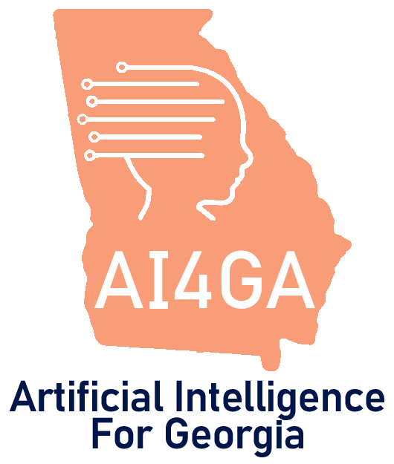
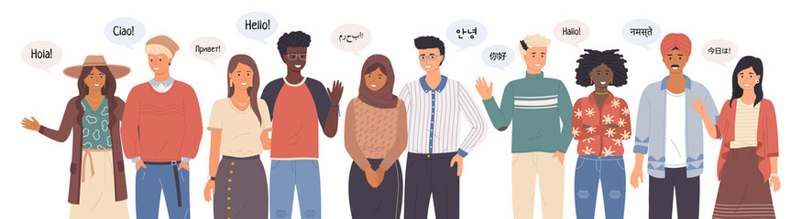

Module 2.1
Module Overview - Understanding Language
Living and Working with Artificial Intelligence
Unit 2
Understanding
Language
Developed for the AI4GA (Artificial Intelligence for Georgia) project funded by National Science Foundation awards DRL-2049029 and DRL-2048502.
This work is licensed under the Creative Commons. Attribution-NonComercial-ShareAlike 4.0 International License. https://creativecommons.org/licenses/by-nc-sa/4.0/

Slide 2

Module 2.2
How Computers Understand What We Say?
Living and Working with Artificial Intelligence
Developed for the AI4GA (Artificial Intelligence for Georgia) project funded by National Science Foundation awards DRL-2049029 and DRL-2048502.
This work is licensed under the Creative Commons. Attribution-NonComercial-ShareAlike 4.0 International License. https://creativecommons.org/licenses/by-nc-sa/4.0/

Slide 3

Module 2.3
How Do Intelligent Assistants Understand & Answer Questions
Living and Working with Artificial Intelligence
Developed for the AI4GA (Artificial Intelligence for Georgia) project funded by National Science Foundation awards DRL-2049029 and DRL-2048502.
This work is licensed under the Creative Commons. Attribution-NonComercial-ShareAlike 4.0 International License. https://creativecommons.org/licenses/by-nc-sa/4.0/

Slide 4
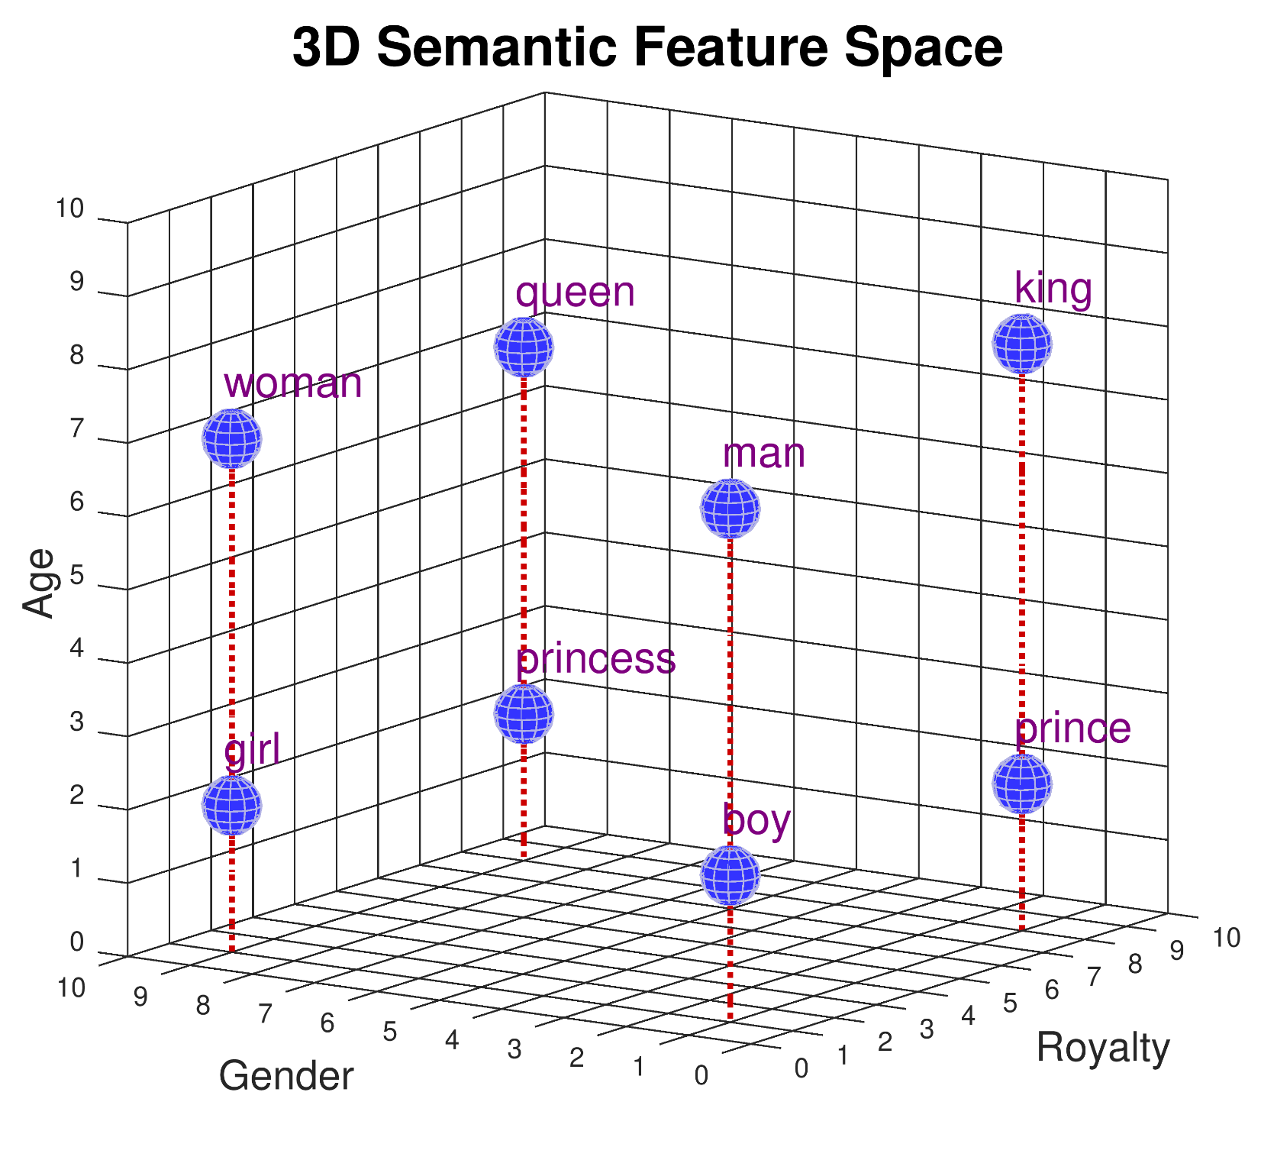
Module 2.4
Word Embeddings
Living and Working with Artificial Intelligence
Developed for the AI4GA (Artificial Intelligence for Georgia) project funded by National Science Foundation awards DRL-2049029 and DRL-2048502.
This work is licensed under the Creative Commons. Attribution-NonComercial-ShareAlike 4.0 International License. https://creativecommons.org/licenses/by-nc-sa/4.0/

Slide 5
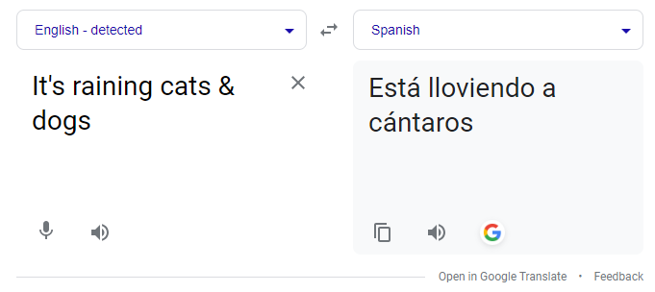
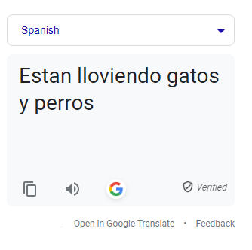
Module 2.5
How computers represent and generate meaning
Living and Working with Artificial Intelligence
vs
Developed for the AI4GA (Artificial Intelligence for Georgia) project funded by National Science Foundation awards DRL-2049029 and DRL-2048502.
This work is licensed under the Creative Commons. Attribution-NonComercial-ShareAlike 4.0 International License. https://creativecommons.org/licenses/by-nc-sa/4.0/

Slide 6
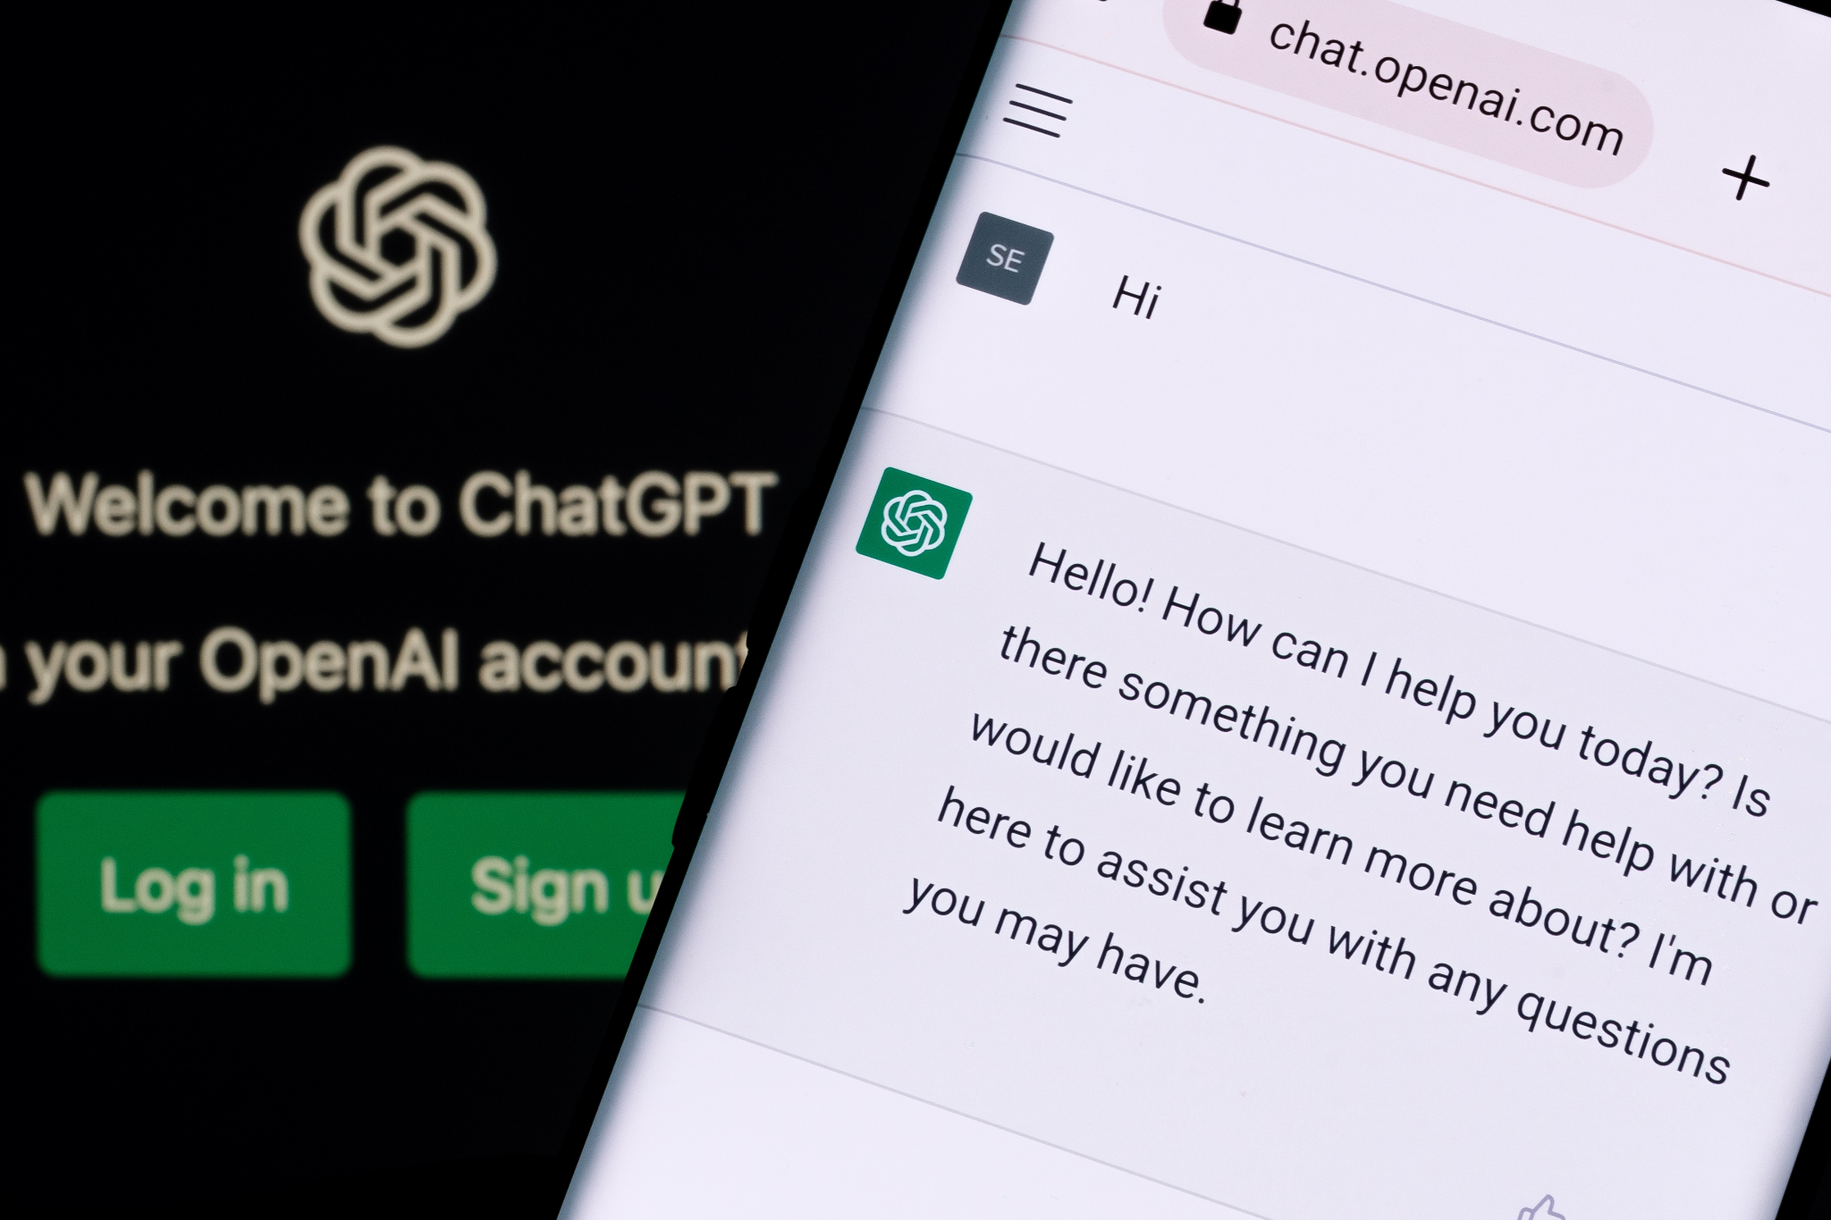
Module 2.6
Case Study: ChatGPT
Living and Working with Artificial Intelligence
Developed for the AI4GA (Artificial Intelligence for Georgia) project funded by National Science Foundation awards DRL-2049029 and DRL-2048502.
This work is licensed under the Creative Commons. Attribution-NonComercial-ShareAlike 4.0 International License. https://creativecommons.org/licenses/by-nc-sa/4.0/

Slide 7
Module 2.7
Mini-Projects
Living and Working with Artificial Intelligence
Developed for the AI4GA (Artificial Intelligence for Georgia) project funded by National Science Foundation awards DRL-2049029 and DRL-2048502.
This work is licensed under the Creative Commons. Attribution-NonComercial-ShareAlike 4.0 International License. https://creativecommons.org/licenses/by-nc-sa/4.0/

Slide 8
Unit 2
Upgrading your Dream Bot
Living and Working with Artificial Intelligence
Developed for the AI4GA (Artificial Intelligence for Georgia) project funded by National Science Foundation awards DRL-2049029 and DRL-2048502.
This work is licensed under the Creative Commons. Attribution-NonComercial-ShareAlike 4.0 International License. https://creativecommons.org/licenses/by-nc-sa/4.0/

